Slide 1

Linux Device Drivers
Lection 2
Roman Okhrimenko 2019

Slide 2
Questions to answer on this lection
1. What is Linux Device Model?
2. How kobject, kset, ktype and other k’s work?
3. Udev service made possible by uevent, that easy (not really)?
4. Is it my job to handle a concurrency in kernel?
5. What synchronization mechanisms exist in kernel?

Slide 3
What is Linux Device Model?
It is an improved way of representation for system hardware layout and its dependencies.
Was developed to ease power system description, as it is highly hierarchical.
Defines a kind of ”abstract class” for device description and following object-oriented model.
Linux kernel exposes all the devices, drivers, buses in the exact hierarchy in which they exist physically in the system through sysfs
Facilitates ref counting, hot plug support, device classes and more

Slide 4
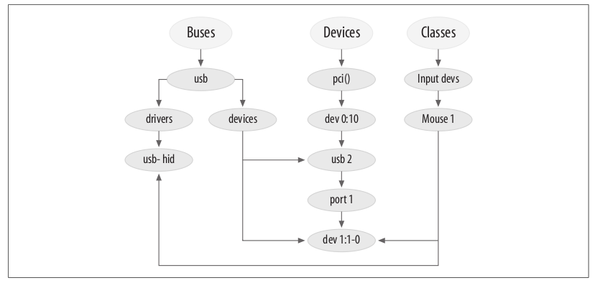
What is Linux Device Model?

Slide 5
kobject, kset, ktype and other k’s
Kobject
Serves as base data structure to implement device model
Entry is created in sysfs for each declared Kobject
May belong to only one subsystem and a subsystem must contain only identically embedded Kobjects
Implements ref counting for its attributes via dentry’s d_fsdata and kref, support classic put(), get() methods to interact
Should link itself to corresponding struct kobj_type

Slide 6
kobject, ktype, kset and other k’s
Ktype
Describes default behavior for a family of kobjects
Kobjects of the same “type” point at the same ktype structure
Declares release method for its kobjects to deconstruct entries when kobjects refs count become zero
Defines sysfs_ops and default_attrs same for related kojects
static struct kobj_type fw_cfg_sysfs_entry_ktype = {
.default_attrs = fw_cfg_sysfs_entry_attrs,
.sysfs_ops = &fw_cfg_sysfs_attr_ops,
.release = fw_cfg_sysfs_release_entry,
};

Slide 7
kobject, ktype, kset and other k’s
Kset
Aggregates collections of kobjects into single place, like bus in /sys/bus – groups all buses in system
Unlike kobj_type only groups kobject in logical subsets and not share functionality
struct kset {
struct list_head list; // list of linked kobjects
spinlock_t list_lock; // spinlock protecting linked list
struct kobject kobj; // base kobject representing this set
const struct kset_uevent_ops *uevent_ops; // points to structure that // describes hotplug behavior
} __randomize_layout;

Slide 8
kobject, ktype, kset and other k’s
Kobject_attribute
Represented as file in sysfs unlike all other k’s
Implements show and store methods to interact with it
Modes and levels of access should be defined as for other files
Use __ATTR macro to set attributes and specify r/w mode
Follow by defining struct attribute and struct attribute_group to pass to sysfs set up routines
There are also binary_attributes

Slide 9
kobject, ktype, kset and other k’s
k’s have self explanatory API
kobject_add(struct kobject *kobj, struct kobject *parent ...);
kobject_del(struct kobject *kobj);
kobject_put(struct kobject *kobj);
struct kset * kset_create_and_add(const char *name, ...);
struct kobj_type *get_ktype(struct kobject *kobj)

Slide 10
kobject, ktype, kset and other k’s
Uevents – user events
Uevents pushed to user space via netlink – a high speed multicast socket used in Linux for IPC on kernel and user space
User space app can easily get uevents by waiting on socket
Udev system service uses this mechanism on startup to create dynamic device directory and populate /dev with devices that are actually detected

Slide 11
Concurrency in kernel
Pics by Alexander Shevchenko of GlobalLogic

Slide 12
Concurrency in kernel

Slide 13
Synchronization mechnisms
Lets disable interrupts:
Easy to implement and manage
Context switch is also disabled
Valid for uni-core, uni-processor system
Pitfalls
System becomes one threaded mode until restore
All interrupts are stacked to “better times” by controller
Can lead to deadlock after all

Slide 14
References
https://bootlin.com/doc/training/linux-kernel/
https://linux-kernel-labs.github.io/master/lectures/intro.html
https://www.kernel.org/doc/html/latest/filesystems/vfs.html
https://www.ibm.com/developerworks/ru/library/l-linux_kernel_01/index.html
http://www.opensourceforu.com/2011/02/linux-character-drivers
https://www.thegeekdiary.com/understanding-the-sysfs-file-system-in-linux/
https://medium.com/@nayangadre/the-kernel-kobject-device-model-explained-89d02350fa03
http://www.cs.utexas.edu/~witchel/372/lectures

